Slide 1
Dimensionality reduction
k. Ramachandra murthy

Slide 2
Why Dimensionality Reduction?
It is so easy and convenient to collect data
Data is not collected only for data mining
Data accumulates in an unprecedented speed
Data pre-processing is an important part for effective machine learning and data mining
Dimensionality reduction is an effective approach to downsizing data

Slide 3
Why Dimensionality Reduction?
Most machine learning and data mining techniques may not be effective for high-dimensional data
  Curse of Dimensionality
  The intrinsic dimension may be small.

Slide 4
Why Dimensionality Reduction?
Visualization: projection of high-dimensional data onto 2D or 3D.
Data compression: efficient storage and retrieval.
Noise removal: positive effect on query accuracy.

Slide 5
Curse of dimensionality

Slide 6
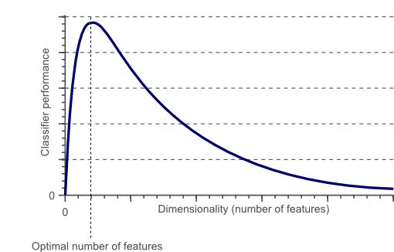
Curse of dimensionality
The required number of samples (to achieve the same accuracy) grows exponentionally with the number of variables!
In practice: number of training examples is fixed!
  => the classifier’s performance usually will degrade for a large number of features!
In fact, after a certain point, increasing the dimensionality of the problem by adding new features would actually degrade the performance of classifier.

Slide 7
Curse of dimensionality
  Many explored domains have hundreds to tens of thousands of variables/features with many irrelevant and redundant ones!
  - In domains with many features the underlying probability distribution can be very complex and very hard to estimate (e.g. dependencies between variables) !
  Irrelevant and redundant features can “confuse” learners!
  Limited training data!
  Limited computational resources!

Slide 8
Example for ML-Problem
Text-Categorization
  Documents are represented by a vector containing word frequency counts of dimension equal to the size of the vocabulary
  Vocabulary ~ 15,000 words (i.e. each document is represented by a 15,000-dimensional vector)
  Typical tasks:
    Automatic sorting of documents into web-directories
    Detection of spam-email

Slide 9
Motivation
Especially when dealing with a large number of variables there is a need for dimensionality reduction!
Dimensionality reduction can significantly improve a learning algorithm’s performance!

Slide 10
Major Techniques of Dimensionality Reduction
Feature Selection
Feature Extraction (Reduction)

Slide 11
Feature extraction vs selection
Feature extraction
  All original features are used and they are transferred
  The transformed features are linear/nonlinear combinations of the original features
Feature selection
  Only a subset of the original features are selected

Slide 12
Feature selection

Slide 13
Feature selection
Feature selection:
Problem of selecting some subset from a set of input features upon which it should focus attention, while ignoring the rest
Humans/animals do that constantly!

Slide 14
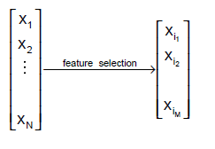
Feature Selection (Def.)
Given a set of N features, the role of feature selection is to select a subset of size M (M < N) that leads to the smallest classification/clustering error.

Slide 15
Why is feature selection? Why not feature extraction?
You may want to extract meaningful rules from your classifier
  When you transform or project, the measurement units (length, weight, etc.) of your features are lost
Features may not be numeric
  A typical situation in the machine learning domain

Slide 16
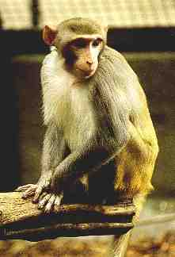
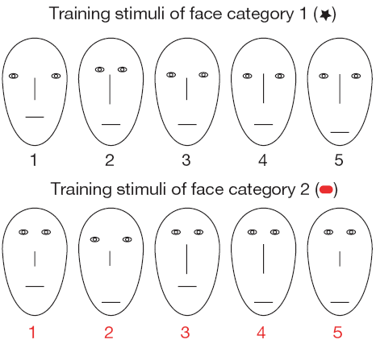
Motivational example from Biology
Monkeys performing classification task
?
Eye separation, Eye height, Mouth height, Nose length

Slide 17
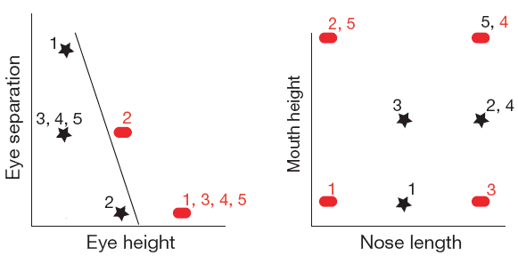
Motivational example from Biology
Monkeys performing classification task
Diagnostic features:
- Eye separation
- Eye height
Non-Diagnostic features:
- Mouth height
- Nose length

Slide 18
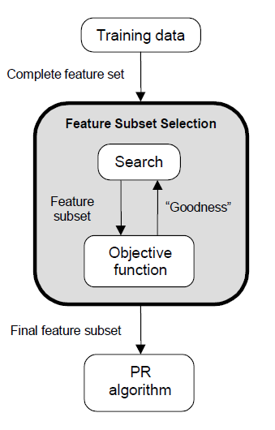
Feature Selection Methods
Feature selection is an optimization problem.
  Search the space of possible feature subsets.
  Pick the subset that is optimal or near-optimal with respect to an objective function.

Slide 19
Feature Selection Methods
Feature selection is an optimization problem.
  Search the space of possible feature subsets.
  Pick the subset that is optimal or near-optimal with respect to a certain criterion.
Search strategies Evaluation strategies
  Optimum - Filter methods
  Heuristic - Wrapper methods
  Randomized

Slide 20
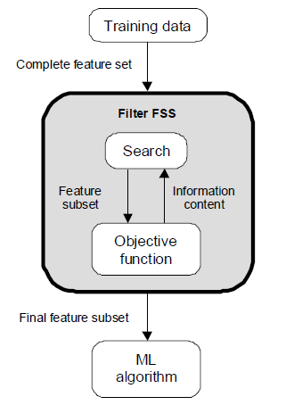
Evaluation Strategies
Filter Methods
  Evaluation is independent of the classification algorithm.
  The objective function evaluates feature subsets by their information content, typically interclass distance, statistical dependence or information-theoretic measures.

Slide 21
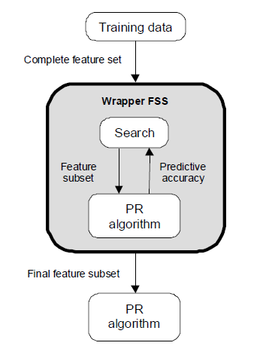
Evaluation Strategies
Wrapper Methods
  Evaluation uses criteria related to the classification algorithm.
  The objective function is a pattern classifier, which evaluates feature subsets by their predictive accuracy (recognition rate on test data) by statistical resampling or cross-validation.

Slide 22
Filter vs Wrapper Approaches
Wrapper Approach
Advantages
  Accuracy: wrappers generally have better recognition rates than filters since they tuned to the specific interactions between the classifier and the features.
  Ability to generalize: wrappers have a mechanism to avoid over fitting, since they typically use cross-validation measures of predictive accuracy.
Disadvantages
  Slow execution

Slide 23
Filter vs Wrapper Approaches (cont’d)
Filter Apporach
Advantages
  Fast execution: Filters generally involve a non-iterative computation on the dataset, which can execute much faster than a classifier training session
  Generality: Since filters evaluate the intrinsic properties of the data, rather than their interactions with a particular classifier, their results exhibit more generality; the solution will be “good” for a large family of classifiers
Disadvantages
  Tendency to select large subsets: Filter objective functions are generally monotonic

Slide 24
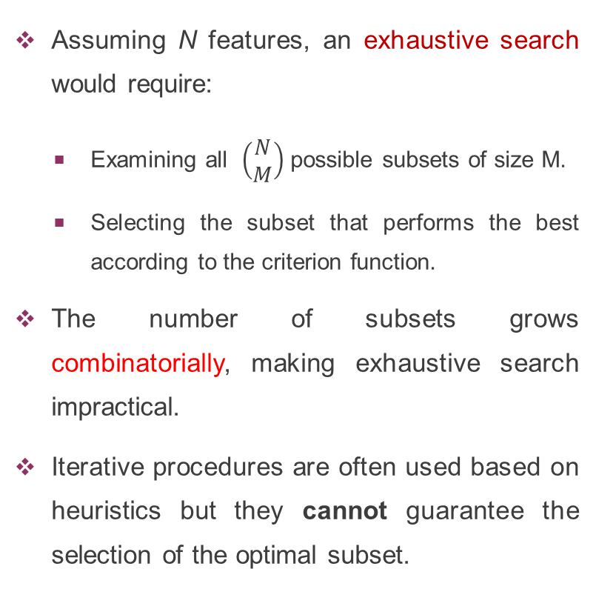
Search Strategies
Assuming N features, an exhaustive search would require:
  Examining all $\left(\begin{matrix}N \\ M\end{matrix}\right)$ possible subsets of size M.
  Selecting the subset that performs the best according to the criterion function.
The number of subsets grows combinatorially, making exhaustive search impractical.
Iterative procedures are often used based on heuristics but they cannot guarantee the selection of the optimal subset.
Four Features – x₁, x₂, x₃, x₄
1,1,1,1
0,1,1,1
1,0,1,1
1,1,0,1
1,1,1,0
0,1,0,1
0,1,0,1
1,0,0,1
0,1,1,0
1,0,1,0
1,1,0,0
0,0,0,1
0,0,1,0
0,1,0,0
1,0,0,0
0,0,0,0
1-x_{i} is selected; 0-x_{i} is not selected

Slide 25
Naïve Search
Sort the given N features in order of their probability of correct recognition.
Select the top M features from this sorted list.
Disadvantage
  Feature correlation is not considered.
  Best pair of features may not even contain the best individual feature.

Slide 26
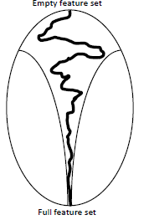
Sequential forward selection (SFS)
(heuristic search)
First, the best single feature is selected (i.e., using some criterion function).
Then, pairs of features are formed using one of the remaining features and this best feature, and the best pair is selected.
Next, triplets of features are formed using one of the remaining features and these two best features, and the best triplet is selected.
This procedure continues until a predefined number of features are selected.
SFS performs best
when the optimal
subset is small.

Slide 27
Sequential forward selection (SFS)
(heuristic search)
{x₁, x₂, x₃, x₄}
{x₂ , x₃ , x₁}
{x₂ , x₃, x₄}
J(x₂, x₃ , x₁)>=J(x₂, x₃, x₄)
{x₂, x₁}
{x₂ , x₃}
{x₂ , x₄}
J(x₂, x₃)>=J(x₂, x_{i}); i=1,4
{x₁} {x₂} {x₃} {x₄}
J(x₂)>=J(x_{i}); i=1,3,4

Slide 28
Illustration (SFS)
1,1,1,1
Four Features – x₁, x₂, x₃, x₄
1-x_{i} is selected; 0-x_{i} is not selected
0,1,1,1
1,0,1,1
1,1,0,1
1,1,1,0
0,1,0,1
0,1,0,1
1,0,0,1
0,1,1,0
1,0,1,0
1,1,0,0
0,0,0,1
0,0,1,0
0,1,0,0
1,0,0,0
0,0,0,0

Slide 29
Illustration (SFS)
1,1,1,1
Four Features – x₁, x₂, x₃, x₄
1-x_{i} is selected; 0-x_{i} is not selected
0,1,1,1
1,0,1,1
1,1,0,1
1,1,1,0
0,1,0,1
0,1,0,1
1,0,0,1
0,1,1,0
1,0,1,0
1,1,0,0
0,0,0,1
0,0,1,0
0,1,0,0
1,0,0,0
x₃
0,0,0,0

Slide 30
Illustration (SFS)
1,1,1,1
Four Features – x₁, x₂, x₃, x₄
1-x_{i} is selected; 0-x_{i} is not selected
0,1,1,1
1,0,1,1
1,1,0,1
1,1,1,0
0,1,0,1
0,1,0,1
1,0,0,1
0,1,1,0
1,0,1,0
1,1,0,0
x₂, x₃
0,0,0,1
0,0,1,0
0,1,0,0
1,0,0,0
x₃
0,0,0,0

Slide 31
Illustration (SFS)
1,1,1,1
Four Features – x₁, x₂, x₃, x₄
1-x_{i} is selected; 0-x_{i} is not selected
0,1,1,1
1,0,1,1
1,1,0,1
1,1,1,0
x₁,x₂, x₃
0,1,0,1
0,1,0,1
1,0,0,1
0,1,1,0
1,0,1,0
1,1,0,0
x₂, x₃
0,0,0,1
0,0,1,0
0,1,0,0
1,0,0,0
x₃
0,0,0,0

Slide 32
Illustration (SFS)
1,1,1,1
Four Features – x₁, x₂, x₃, x₄
1-x_{i} is selected; 0-x_{i} is not selected
0,1,1,1
1,0,1,1
1,1,0,1
1,1,1,0
x₁,x₂, x₃
0,1,0,1
0,1,0,1
1,0,0,1
0,1,1,0
1,0,1,0
1,1,0,0
x₂, x₃
0,0,0,1
0,0,1,0
0,1,0,0
1,0,0,0
x₃
0,0,0,0

Slide 33
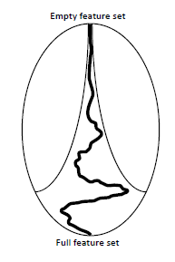
Sequential backward selection (SBS) (heuristic search)
First, the criterion function is computed for all n features.
Then, each feature is deleted one at a time, the criterion function is computed for all subsets with n-1 features, and the worst feature is discarded.
Next, each feature among the remaining n-1 is deleted one at a time, and the worst feature is discarded to form a subset with n-2 features.
This procedure continues until a predefined number of features are left.
SBS performs best when the optimal subset is large.

Slide 34
Sequential backward selection (SBS) (heuristic search)
{x₁, x₂, x₃, x₄}
{x₁, x₂, x₃}
J(x₁, x₂, x₃) is maximum
x₃ is the worst feature
{x₂, x₃, x₄}
{x₁, x₃, x₄}
J(x₂, x₃) is maximum
x₁ is the worst feature
{x₂, x₃}
{x₁, x₃}
{x₁, x₂}
{x₂} {x₃}
J(x₂) is maximum
x₃ is the worst feature

Slide 35
Illustration (SBS)
1,1,1,1
Four Features – x₁, x₂, x₃, x₄
1-x_{i} is selected; 0-x_{i} is not selected
0,1,1,1
1,0,1,1
1,1,0,1
1,1,1,0
0,1,0,1
0,1,0,1
1,0,0,1
0,1,1,0
1,0,1,0
1,1,0,0
0,0,0,1
0,0,1,0
0,1,0,0
1,0,0,0
0,0,0,0

Slide 36
Illustration (SBS)
1,1,1,1
Four Features – x₁, x₂, x₃, x₄
1-x_{i} is selected; 0-x_{i} is not selected
0,1,1,1
1,0,1,1
1,1,0,1
1,1,1,0
x₁, x₂, x₃
0,1,0,1
0,1,0,1
1,0,0,1
0,1,1,0
1,0,1,0
1,1,0,0
0,0,0,1
0,0,1,0
0,1,0,0
1,0,0,0
0,0,0,0

Slide 37
Illustration (SBS)
1,1,1,1
Four Features – x₁, x₂, x₃, x₄
1-x_{i} is selected; 0-x_{i} is not selected
0,1,1,1
1,0,1,1
1,1,0,1
1,1,1,0
x₁, x₂, x₃
0,1,0,1
0,1,0,1
1,0,0,1
0,1,1,0
1,0,1,0
1,1,0,0
x₂, x₃
0,0,0,1
0,0,1,0
0,1,0,0
1,0,0,0
0,0,0,0

Slide 38
Illustration (SBS)
1,1,1,1
Four Features – x₁, x₂, x₃, x₄
1-x_{i} is selected; 0-x_{i} is not selected
0,1,1,1
1,0,1,1
1,1,0,1
1,1,1,0
x₁, x₂, x₃
0,1,0,1
0,1,0,1
1,0,0,1
0,1,1,0
1,0,1,0
1,1,0,0
x₂, x₃
0,0,0,1
0,0,1,0
0,1,0,0
1,0,0,0
x₂
0,0,0,0

Slide 39
Illustration (SBS)
1,1,1,1
Four Features – x₁, x₂, x₃, x₄
1-x_{i} is selected; 0-x_{i} is not selected
0,1,1,1
1,0,1,1
1,1,0,1
1,1,1,0
x₁, x₂, x₃
0,1,0,1
0,1,0,1
1,0,0,1
0,1,1,0
1,0,1,0
1,1,0,0
x₂, x₃
0,0,0,1
0,0,1,0
0,1,0,0
1,0,0,0
x₂
0,0,0,0

Slide 40
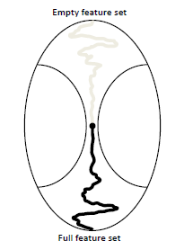
Bidirectional Search (BDS) (heuristic search)
BDS applies SFS and SBS simultaneously:
  SFS is performed from the empty set
  SBS is performed from the full set
To guarantee that SFS and SBS converge to the same solution
  Features already selected by SFS are not removed by SBS
  Features already removed by SBS are not selected by SFS

Slide 41

Bidirectional Search (BDS)
SBS
{x₁, x₂, x₃, x₄}
SFS
$$φ$$

Slide 42
Bidirectional Search (BDS)
SBS
{x₁, x₂, x₃, x₄}
{x₁}
{x₂}
{x₃}
{x₄}
J(x₂) is maximum
x₂ is selected
SFS
$$φ$$

Slide 43
Bidirectional Search (BDS)
SBS
{x₁, x₂, x₃, x₄}
{x₂, x₃, x₄}
{x₂, x₁, x₄}
{x₂, x₂, x₃}
{x₁}
{x₂}
{x₃}
{x₄}
J(x₂) is maximum
x₂ is selected
SFS
$$φ$$

Slide 44
Bidirectional Search (BDS)
SBS
{x₁, x₂, x₃, x₄}
{x₂, x₃, x₄}
{x₂, x₁, x₄}
{x₂, x₂, x₃}
J(x₂, x₁, x₄) is maximum
x₃ is removed
{x₁}
{x₂}
{x₃}
{x₄}
J(x₂) is maximum
x₂ is selected
SFS
$$φ$$

Slide 45
Bidirectional Search (BDS)
SBS
{x₁, x₂, x₃, x₄}
{x₂, x₃, x₄}
{x₂, x₁, x₄}
{x₂, x₂, x₃}
J(x₂, x₁, x₄) is maximum
x₃ is removed
{x₂, x₁}
{x₂, x₄}
{x₁}
{x₂}
{x₃}
{x₄}
J(x₂) is maximum
x₂ is selected
SFS
$$φ$$

Slide 46
Bidirectional Search (BDS)
SBS
{x₁, x₂, x₃, x₄}
{x₂, x₃, x₄}
{x₂, x₁, x₄}
{x₂, x₂, x₃}
J(x₂, x₁, x₄) is maximum
x₃ is removed
{x₂, x₁}
{x₂, x₄}
J(x₂, x₄) is maximum
x₄ is selected
{x₁}
{x₂}
{x₃}
{x₄}
J(x₂) is maximum
x₂ is selected
SFS
$$φ$$

Slide 47
Bidirectional Search (BDS)
SBS
{x₁, x₂, x₃, x₄}
{x₂, x₃, x₄}
{x₂, x₁, x₄}
{x₂, x₂, x₃}
J(x₂, x₁, x₄) is maximum
x₃ is removed
{x₂, x₁}
{x₂, x₄}
J(x₂, x₄) is maximum
x₄ is selected
{x₁}
{x₂}
{x₃}
{x₄}
J(x₂) is maximum
x₂ is selected
SFS
$$φ$$

Slide 48
Bidirectional Search (BDS)
SBS
{x₁, x₂, x₃, x₄}
{x₂, x₃, x₄}
{x₂, x₁, x₄}
{x₂, x₂, x₃}
J(x₂, x₁, x₄) is maximum
x₃ is removed
{x₂, x₁}
{x₂, x₄}
J(x₂, x₄) is maximum
x₄ is selected
{x₁}
{x₂}
{x₃}
{x₄}
J(x₂) is maximum
x₂ is selected
SFS
$$φ$$

Slide 49
Bidirectional Search (BDS)
SBS
{x₁, x₂, x₃, x₄}
{x₂, x₃, x₄}
{x₂, x₁, x₄}
{x₂, x₂, x₃}
J(x₂, x₁, x₄) is maximum
x₃ is removed
{x₂, x₁}
{x₂, x₄}
J(x₂, x₄) is maximum
x₄ is selected
{x₁}
{x₂}
{x₃}
{x₄}
J(x₂) is maximum
x₂ is selected
SFS
$$φ$$

Slide 50
Illustration (BDS)
1,1,1,1
Four Features – x₁, x₂, x₃, x₄
1-x_{i} is selected; 0-x_{i} is not selected
0,1,1,1
1,0,1,1
1,1,0,1
1,1,1,0
0,1,0,1
0,1,0,1
1,0,0,1
0,1,1,0
1,0,1,0
1,1,0,0
0,0,0,1
0,0,1,0
0,1,0,0
1,0,0,0
0,0,0,0

Slide 51
Illustration (BDS)
1,1,1,1
Four Features – x₁, x₂, x₃, x₄
1-x_{i} is selected; 0-x_{i} is not selected
0,1,1,1
1,0,1,1
1,1,0,1
1,1,1,0
0,1,0,1
0,1,0,1
1,0,0,1
0,1,1,0
1,0,1,0
1,1,0,0
0,0,0,1
0,0,1,0
0,1,0,0
1,0,0,0
0,0,0,0

Slide 52
Illustration (BDS)
1,1,1,1
Four Features – x₁, x₂, x₃, x₄
1-x_{i} is selected; 0-x_{i} is not selected
0,1,1,1
1,0,1,1
1,1,0,1
1,1,1,0
0,1,0,1
0,1,0,1
1,0,0,1
0,1,1,0
1,0,1,0
1,1,0,0
0,0,0,1
0,0,1,0
0,1,0,0
1,0,0,0
x₂
0,0,0,0

Slide 53
Illustration (BDS)
1,1,1,1
Four Features – x₁, x₂, x₃, x₄
1-x_{i} is selected; 0-x_{i} is not selected
0,1,1,1
1,0,1,1
x₂, x₁, x₄
1,1,0,1
1,1,1,0
0,1,0,1
0,1,0,1
1,0,0,1
0,1,1,0
1,0,1,0
1,1,0,0
0,0,0,1
0,0,1,0
0,1,0,0
1,0,0,0
x₂
0,0,0,0

Slide 54
Illustration (BDS)
1,1,1,1
Four Features – x₁, x₂, x₃, x₄
1-x_{i} is selected; 0-x_{i} is not selected
0,1,1,1
1,0,1,1
x₂, x₁, x₄
1,1,0,1
1,1,1,0
x₂, x₄
0,1,0,1
0,1,0,1
1,0,0,1
0,1,1,0
1,0,1,0
1,1,0,0
0,0,0,1
0,0,1,0
0,1,0,0
1,0,0,0
x₂
0,0,0,0

Slide 55
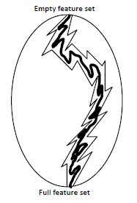
“Plus-L, minus-R” selection (LRS) (heuristic search)
A generalization of SFS and SBS
  If L>R, LRS starts from the empty set and:
    Repeatedly add L features
    Repeatedly remove R features
  If L<R, LRS starts from the full set and:
    Repeatedly removes R features
    Repeatedly add L features
LRS attempts to compensate for the weaknesses of SFS and SBS with some backtracking capabilities.

Slide 56
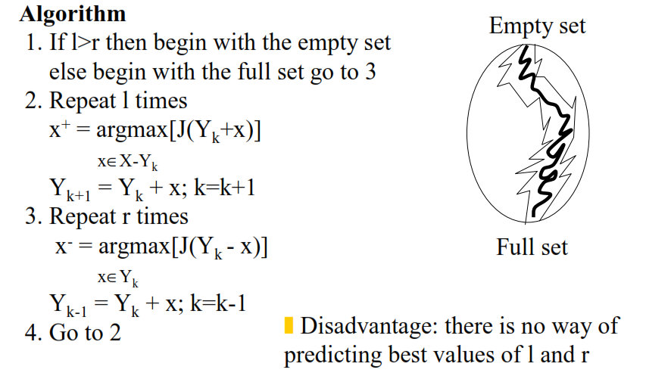
“Plus-L, minus-R” selection (LRS) (heuristic search)

Slide 57
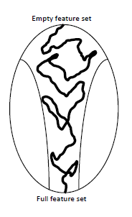
Sequential floating selection
(SFFS and SFBS) (heuristic search)
An extension to LRS with flexible backtracking capabilities
  Rather than fixing the values of L and R, floating methods determine these values from the data.
  The dimensionality of the subset during the search can be thought to be “floating” up and down
There are two floating methods:
  Sequential Floating Forward Selection (SFFS)
  Sequential Floating Backward Selection (SFBS)

Slide 58
Sequential floating Forward selection
Step 1 (Inclusion): Use the basic SFS method to select the most significant feature with respect to X and Include it in X. Stop if d features have been selected, otherwise go to step 2.
Step 2 (Conditional exclusion): Find the least significant feature k in X. If it is the feature just added, then keep it and return to step 1. Otherwise, exclude the feature k. Note that X is now better than it was before step 1. Continue to step 3.
Step 3 (Continuation of conditional exclusion) Again find the least significant feature in X. If its removal will
  leave X with at least 2 features, and
  the value of J(X) is greater than the criterion value of the best feature subset of that size found so far, then remove it and repeat step 3. When these two conditions cease to be satisfied, return to step 1.

Slide 59
Sequential floating selection
(SFFS and SFBS)
SFFS
  Sequential floating forward selection (SFFS) starts from the empty set.
  After each forward step, SFFS performs backward steps as long as the objective function increases.
SFBS
  Sequential floating backward selection (SFBS) starts from the full set.
  After each backward step, SFBS performs forward steps as long as the objective function increases.

